Slide 1

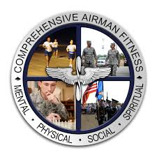

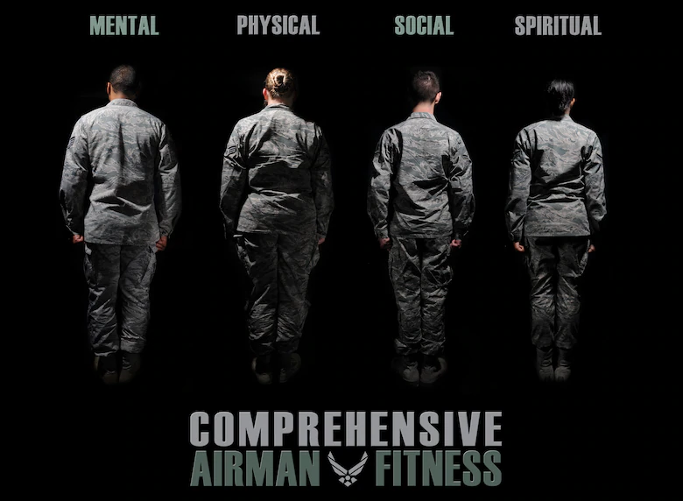

In Need Of Resiliency Tools?
The Deployment Transition Center (DTC) Can Provide The Following Classes
Topics Offered:
Identifying Stress and How to Manage it
How to Resolve Conflict in the Workplace
How to Connect
Building Confidence
Emotional Bearings
Effective Communication/Active Listening
Giving/Taking Constructive Feedback
Team Building
Positive Thinking, We Are What We Think
Responsible Drinking
Sleep Hygiene
Healthy Relationships
Course descriptions and request form can be found under Resiliency Links on the Ramstein Resiliency Tools website:
https://www.ramstein.af.mil/Resiliency-Tools/
If your unit or squadron are in need of resiliency courses, classes are available and can be accomplished at the DTC facility or at your squadron. DTC amenities include massage chairs, prayer room, fitness area, video games, art room, music area and more.
Questions:
afdeployment.transitioncenter@us.af.mil
DSN: 314-478-4591

